Slide 1
Innovations In Stroke Identification A Machine Learning-Based Diagnostic Model Using Neuroimages

Slide 2
INDEX
Abstract
Objective of project
Problem Statement
Scope & Motivation
Introduction
Literature survey
Existing Method
Disadvantages
Proposed method
Advantages
Project Flow
Hardware and Software Requirements
Architecture
Modules
Methodology/algorithm
UMLS
Output screens
Conclusion
Future enhancement
References

Slide 3
ABSTRACT
The early and accurate diagnosis of stroke is critical for effective treatment and improved patient outcomes. Traditional diagnostic methods often face challenges in achieving high accuracy and efficiency. In this study, we propose an innovative machine learning-based diagnostic model utilizing ResNet and MobileNet architectures to classify neuroimages into normal and stroke categories. Our approach leverages the robust feature extraction capabilities of ResNet and the lightweight, efficient nature of MobileNet to create a comprehensive diagnostic tool. The model is trained on a diverse dataset of neuroimages, incorporating advanced preprocessing techniques to enhance its generalizability and performance. Initial experiments demonstrate that ResNet achieves a training accuracy of 94% with normal images, while MobileNet achieves an impressive 92% training accuracy with normal images. These results highlight the potential of our proposed model to significantly improve the accuracy and speed of stroke diagnosis, providing a valuable tool for clinicians and healthcare providers. Future work will focus on further validation with larger datasets and real-world clinical trials to establish the model's efficacy and reliability in clinical settings. This study underscores the transformative potential of deep learning models in advancing stroke diagnosis and enhancing patient care.
Keywords: Stroke Diagnosis, Machine Learning, Deep Learning, ResNet, MobileNet, Neuroimages, Medical Imaging, Stroke Classification, Diagnostic Model, Healthcare AI.

Slide 4
OBJECTIVE OF PROJECT
The primary objective of this project is to develop a machine learning-based diagnostic model utilizing ResNet and MobileNet architectures to accurately classify neuroimages into normal and stroke categories. By leveraging the advanced feature extraction capabilities of ResNet and the efficiency of MobileNet, the project aims to create a robust and efficient diagnostic tool. This model seeks to enhance the accuracy and speed of stroke diagnosis, providing clinicians with a powerful tool for early detection and timely intervention, ultimately improving patient outcomes and quality of care.

Slide 5
PROBLEM STATEMENT
The early and accurate diagnosis of stroke is critical for effective treatment, yet current diagnostic methods often lack the necessary accuracy and speed, leading to delayed interventions and suboptimal patient outcomes. Existing imaging techniques and traditional diagnostic tools can be inefficient and prone to errors. This study seeks to address these limitations by developing a machine learning-based diagnostic model using ResNet and MobileNet architectures. The goal is to create a robust, efficient tool that can accurately classify neuroimages into normal and stroke categories, thereby improving diagnostic precision, expediting treatment, and ultimately enhancing patient care and outcomes.

Slide 6
MOTIVATION
The accurate diagnosis of stroke is crucial for improving patient outcomes, yet traditional methods often lack speed and precision. Machine learning and deep learning, particularly using architectures like ResNet and MobileNet, offer transformative potential for medical diagnostics. ResNet's feature extraction and MobileNet's efficiency make them ideal for swiftly classifying neuroimages into normal and stroke categories. This study aims to harness these technologies to enhance diagnostic accuracy and speed, providing clinicians with a powerful AI-driven tool. Integrating these innovations into clinical workflows can improve healthcare outcomes, reduce morbidity, and enhance the quality of life for stroke patients globally.

Slide 7
SCOPE
This project encompasses the development and validation of a machine learning-based diagnostic model using ResNet and MobileNet to classify neuroimages into normal and stroke categories. The scope includes data collection, preprocessing, model training, and evaluation using a diverse dataset of neuroimages. Additionally, the project aims to optimize the model's performance and generalizability, ensuring it is robust and efficient for clinical use. Future work will involve real-world testing in clinical settings, integration with existing healthcare systems, and continuous improvement based on feedback. The ultimate goal is to provide a reliable tool that enhances the accuracy and speed of stroke diagnosis in medical practice.

Slide 8
INTRODUCTION
Stroke is a leading cause of morbidity and mortality worldwide, necessitating rapid and accurate diagnosis for effective treatment. Early intervention is crucial to minimizing the adverse effects and improving patient outcomes. However, traditional diagnostic methods, relying heavily on manual interpretation of neuroimages, often suffer from limitations in accuracy and efficiency. The advent of machine learning and deep learning technologies offers a promising avenue to address these challenges. This study focuses on developing a machine learning-based diagnostic model utilizing two state-of-the-art neural network architectures: ResNet and MobileNet. ResNet is renowned for its robust feature extraction capabilities, while MobileNet is celebrated for its efficiency and lightweight design, making it suitable for real-time applications. By leveraging these advanced architectures, the proposed model aims to classify neuroimages into normal and stroke categories with high precision and speed. The integration of such a model into clinical workflows has the potential to significantly enhance diagnostic accuracy, reduce the time to diagnosis, and ultimately improve patient care. This research not only aims to advance the technical capabilities of stroke diagnosis but also aspires to set a precedent for the application of deep learning models in other areas of medical diagnostics, paving the way for more intelligent and efficient healthcare solutions.

Slide 9
LITERATURE SURVEY
S.NO | YEAR | AUTHORS | TITLE | OUT COMES
1 | 2018 | H. S. Joo, & D. G. Park | Automatic Detection and Classification of Stroke using Machine Learning | This study explores the application of machine learning techniques for automatic detection and classification of stroke using neuroimages. The authors used various machine learning algorithms, including support vector machines (SVM) and decision trees, achieving significant improvements in diagnostic accuracy. This work provides a strong foundation for developing advanced diagnostic models for stroke identification
2 | 2017 | K. Kamnitsas, C. Ledig, V. F. Newcombe, J. P. Simpson | Efficient Multi-Scale 3D CNN with Fully Connected CRF for Accurate Brain Lesion Segmentation | The authors propose an efficient multi-scale 3D convolutional neural network (CNN) for accurate brain lesion segmentation, which is crucial for stroke diagnosis. By combining CNN with fully connected conditional random fields (CRF), they achieved high segmentation accuracy, demonstrating the potential of deep learning in neuroimaging applications.

Slide 10
LITERATURE SURVEY
S.NO | YEAR | AUTHORS | TITLE | OUT COMES
3 | 2019 | L. Liu, H. Wang, X. Tian, & L. Wang | Deep Learning in Medical Ultrasound Image Analysis: A Review | This review discusses the application of deep learning techniques in medical ultrasound image analysis, including stroke diagnosis. The authors highlight the advantages of deep learning models, such as CNNs and recurrent neural networks (RNNs), in handling complex medical images and improving diagnostic performance.
4 | 2018 | Z. Li, Y. Wang, S. Yang, & J. Zhang | Brain Stroke Lesion Segmentation Using Convolutional Neural Networks | This paper presents a method for brain stroke lesion segmentation using convolutional neural networks (CNNs). The authors developed a CNN-based model that accurately segments stroke lesions in neuroimages, facilitating early diagnosis and treatment. Their work underscores the effectiveness of CNNs in medical image analysis and stroke identification.

Slide 11
EXISTING SYSTEM
The current approach to stroke diagnosis heavily relies on manual interpretation of neuroimages by radiologists, supported by conventional imaging techniques such as CT scans and MRI. While effective, these methods are often time-consuming and susceptible to human error, potentially leading to delays in treatment and affecting patient outcomes. To enhance diagnostic accuracy and efficiency, deep learning techniques like Convolutional Neural Networks (CNN) are leveraged for their ability to extract intricate features from neuroimages, further enhancing the diagnostic capabilities of the system.

Slide 12
ADVANTAGES
• Time-consuming manual interpretation of neuroimages.
• Susceptibility to human error, leading to diagnostic inaccuracies.
• Limited scalability for large volumes of patient data.
• Delays in treatment due to inefficient diagnostic processes.
• Potential for variability in diagnostic outcomes among different radiologists.

Slide 13
PROPOSED SYSTEM
The proposed system leverages ResNet and MobileNet architectures to develop a machine learning-based diagnostic model for classifying neuroimages into normal and stroke categories. This approach aims to enhance diagnostic accuracy and speed, reduce human error, and provide a scalable, efficient solution for early stroke detection in clinical settings.
ADVANTAGES
• Increased Accuracy: Enhanced diagnostic precision through advanced neural network architectures.
• Speed: Faster processing and classification of neuroimages, enabling timely interventions.
• Consistency: Reduced variability in diagnostic outcomes, ensuring reliable results.
• Scalability: Efficient handling of large volumes of patient data, suitable for widespread clinical use.
• Reduced Human Error: Automated analysis minimizes the risk of diagnostic inaccuracies associated with manual interpretation

Slide 14
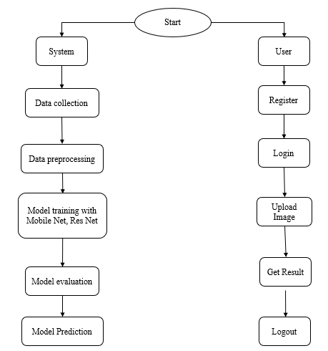
PROJECT FLOW DIAGRAM

Slide 15
HARDWARE & SOFTWARE REQUIREMENTS
HARDWARE REQUIREMENTS
Processor - I3/Intel Processor
RAM - 8GB (min)
Hard Disk - 128 GB
Key Board - Standard Windows Keyboard
Mouse - Two or Three Button Mouse
Monitor - Any

Slide 16
HARDWARE & SOFTWARE REQUIREMENTS
SOFTWARE REQUIREMENTS
Operating System : Windows 7/8/10
Server side Script : HTML, CSS, Bootstrap & JS
Programming Language : Python
Libraries Flask, Pandas, Torch, Keras, Sklearn, Numpy , Seaborn
IDE/Workbench : VSCode
Server Deployment : Xampp Server
Database : MySQL

Slide 17
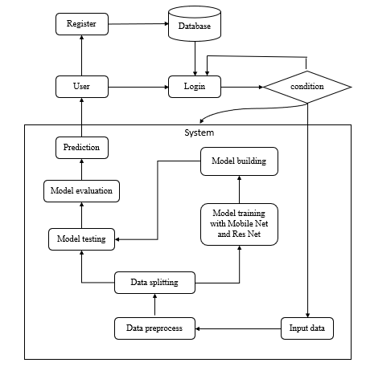
ARCHITECHTURE DIAGRAM

Slide 18
FUNCTIONAL AND NONFUNCTIONAL REQUIREMENTS
Requirement’s analysis is very critical process that enables the success of a system or software project to be assessed. Requirements are generally split into two types: Functional and nonfunctional requirements.
Functional Requirements: These are the requirements that the end user specifically demands as basic facilities that the system should offer. All these functionalities need to be necessarily incorporated into the system as a part of the contract. These are represented or stated in the form of input to be given to the system, the operation performed and the output expected. They are basically the requirements stated by the user which one can see directly in the final product, unlike the nonfunctional requirements.

Slide 19
FUNCTIONAL AND NONFUNCTIONAL REQUIREMENTS
Examples of functional requirements:
Authentication of user whenever he/she logs into the system
System shutdown in case of a cyberattack
A verification email is sent to user whenever he/she register for the first time on some software system.
Nonfunctional requirements: These are basically the quality constraints that the system must satisfy according to the project contract. The priority or extent to which these factors are implemented varies from one project to other. They are also called nonbehavioral requirements.

Slide 20
MODULES
1. System Module:
1.1 Data Collection: In this module, the dataset containing images for stroke identification is divided into two subsets: the training dataset and the testing dataset. This split is typically done with a test size of 20%. The training dataset is used to teach the model, while the testing dataset is used to evaluate its performance.
1.2 Data Splitting: The pre-processed dataset is split into two subsets:
1) Model Training: The training process involves fine-tuning the parameters of the auto-encoder model to minimize reconstruction errors and effectively enhance text clarity in noisy images. This process takes 80% of the data from the dataset.
2) Model Testing: The remaining 20% of the dataset is used for testing. In this process, the trained model makes predictions, and its performance is evaluated based on accuracy and other metrics.

Slide 21
MODULES
1. System Module:
1.3 Model Training: The training process involves using 80% of the dataset to teach the model. The model parameters are fine-tuned to minimize reconstruction errors through iterative optimization techniques, such as gradient descent.
1.4 Model Testing: The remaining 20% of the dataset is used for testing. The trained model predicts the segmentation of ischemic stroke lesions, and its performance is evaluated to determine the model's accuracy.
1.5 Model Saving: Once trained, the model is saved in a .pt format, preserving its learned weights and biases.
1.6 Model Prediction: Finally, we can input new images into the trained model to predict stroke.

Slide 22
MODULES
2. User Module:
2.1 Register: Users should first register with their credentials to create an account in the system.
2.2 Login: Users can log in with their registered credentials to access the system.
2.3 Upload Data: Users can upload their images to predict whether it is stroke or normal.
2.4 Viewing Results: That uploaded image will going to the model part to predict and it will give the prediction and user can view the result.
2.5 Logout: Finally, users can log out of the system to secure their session and personal data.

Slide 23
METHODOLOGY
• Mobile Net:
MobileNet is a lightweight, efficient deep learning model designed for mobile and embedded vision applications. In this project, MobileNet is used for the classification of neuroimages into normal and stroke categories. The model architecture is optimized for speed and performance, making it suitable for real-time applications. MobileNet's depthwise separable convolutions significantly reduce the number of parameters, allowing it to maintain high accuracy while being computationally efficient. The model is trained on a diverse dataset of neuroimages, leveraging advanced preprocessing techniques to enhance its generalizability and performance. MobileNet's ability to efficiently process images and extract relevant features makes it an ideal choice for the stroke identification task

Slide 24
METHODOLOGY
• ResNet:
ResNet, short for Residual Networks, is a deep learning model known for its robustness and ability to train very deep neural networks. In this project, ResNet is utilized to classify neuroimages into normal and stroke categories. ResNet's architecture addresses the vanishing gradient problem by introducing residual connections, which allow gradients to flow through the network more effectively during training. This enables the model to learn complex patterns and features from the neuroimages, improving classification accuracy. The model is trained using a dataset of neuroimages, incorporating data augmentation and preprocessing techniques to enhance its robustness. ResNet's powerful feature extraction capabilities make it a strong candidate for accurately identifying stroke in neuroimages.
By leveraging the strengths of both MobileNet and ResNet, this project aims to create a robust and efficient diagnostic model for stroke identification. MobileNet provides a lightweight, fast, and efficient solution, while ResNet offers powerful feature extraction capabilities. Together, these models form a comprehensive approach to accurately classify neuroimages, improving the early diagnosis and treatment of stroke.

Slide 25
UML DIAGRAMS
Use Case Diagram: A use case diagram in the Unified Modeling Language (UML) is a type of behavioral diagram defined by and created from a Use-case analysis. Its purpose is to present a graphical overview of the functionality provided by a system in terms of actors, their goals (represented as use cases), and any dependencies between those use cases. The main purpose of a use case diagram is to show what system functions are performed for which actor. Roles of the actors in the system can be depicted.

Slide 26
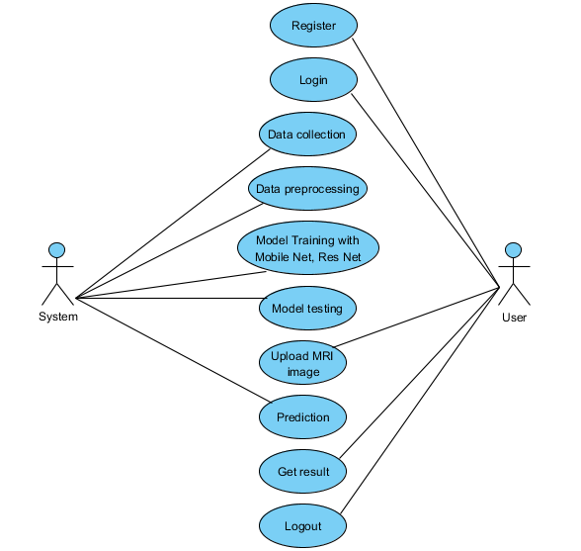
UML DIAGRAMS
Fig: Use Case Diagram

Slide 27
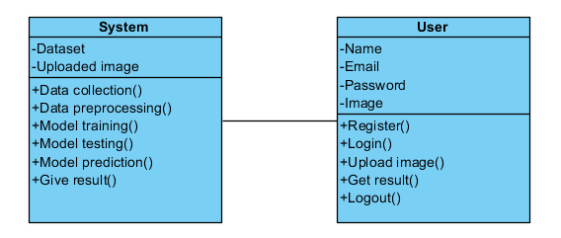
UML DIAGRAMS
Class Diagram:
In software engineering, a class diagram in the Unified Modelling Language (UML) is a type of static structure diagram that describes the structure of a system by showing the system's classes, their attributes, operations (or methods), and the relationships among the classes. It explains which class contains information.

Slide 28
UML DIAGRAMS
Sequence Diagram: A sequence diagram in Unified Modelling Language (UML) is a kind of interaction diagram that shows how processes operate with one another and in what order. It is a construct of a Message Sequence Chart. Sequence diagrams are sometimes called event diagrams, event scenarios, and timing diagrams.

Slide 29
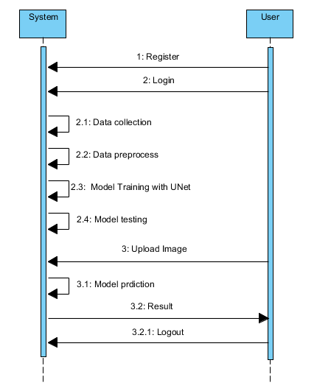
UML DIAGRAMS
Fig: Sequence Diagram

Slide 30
UML DIAGRAMS
Collaboration Diagram:
In collaboration diagram the method call sequence is indicated by some numbering technique as shown below. The number indicates how the methods are called one after another. We have taken the same order management system to describe the collaboration diagram. The method calls are similar to that of a sequence diagram. But the difference is that the sequence diagram does not describe the object organization whereas the collaboration diagram shows the object organization.

Slide 31
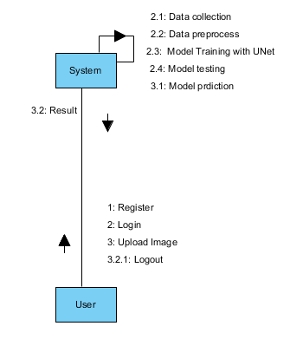
UML DIAGRAMS
Fig: Collaboration Diagram

Slide 32
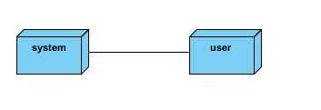
UML DIAGRAMS
Deployment Diagram
Deployment diagram represents the deployment view of a system. It is related to the component diagram. Because the components are deployed using the deployment diagrams. A deployment diagram consists of nodes. Nodes are nothing but physical hardware’s used to deploy the application.

Slide 33
UML DIAGRAMS
Activity Diagram:
Activity diagrams are graphical representations of workflows of stepwise activities and actions with support for choice, iteration and concurrency. In the Unified Modelling Language, activity diagrams can be used to describe the business and operational step-by-step workflows of components in a system. An activity diagram shows the overall flow of control.

Slide 34
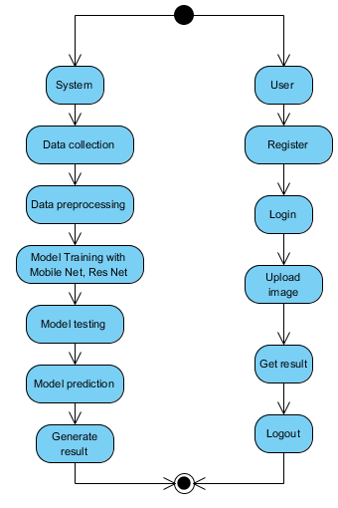
UML DIAGRAMS
Fig: Activity Diagram

Slide 35

UML DIAGRAMS
Component Diagram:
A component diagram, also known as a UML component diagram, describes the organization and wiring of the physical components in a system. Component diagrams are often drawn to help model implementation details and double-check that every aspect of the system's required functions is covered by planned development.

Slide 36
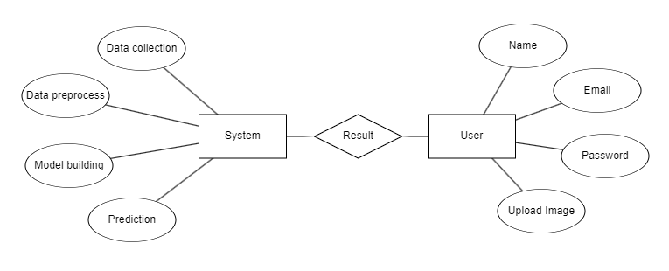
UML DIAGRAMS
ER Diagram: An Entity–relationship model (ER model) describes the structure of a database with the help of a diagram, which is known as Entity Relationship Diagram (ER Diagram). An ER model is a design or blueprint of a database that can later be implemented as a database. The main components of E-R model are: entity set and relationship set. An ER diagram shows the relationship among entity sets. An entity set is a group of similar entities and these entities can have attributes. In terms of DBMS, an entity is a table or attribute of a table in database, so by showing relationship among tables and their attributes, ER diagram shows the complete logical structure of a database. Let’s have a look at a simple ER diagram to understand this concept.

Slide 37
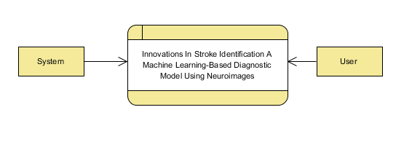
UML DIAGRAMS
DFD Diagram: A Data Flow Diagram (DFD) is a traditional way to visualize the information flows within a system. A neat and clear DFD can depict a good amount of the system requirements graphically. It can be manual, automated, or a combination of both. It shows how information enters and leaves the system, what changes the information and where information is stored. The purpose of a DFD is to show the scope and boundaries of a system as a whole. It may be used as a communications tool between a systems analyst and any person who plays a part in the system that acts as the starting point for redesigning a system.
Fig: Context level Diagram

Slide 38
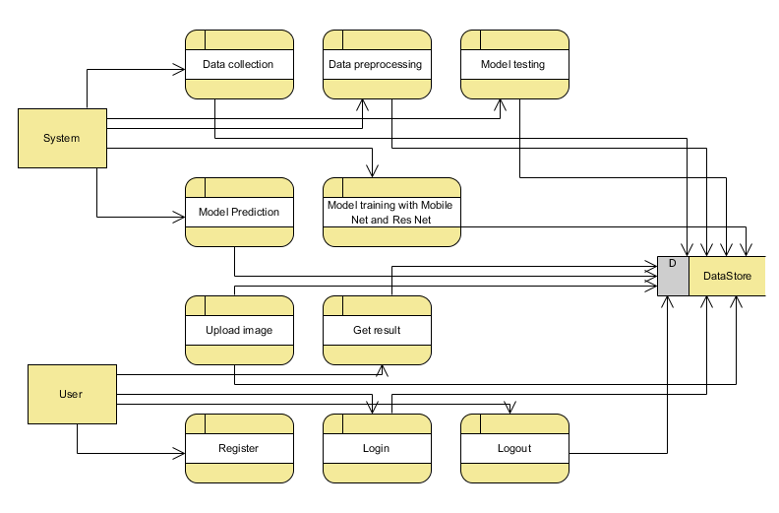
UML DIAGRAMS
FigureLevel-1 diagram

Slide 39
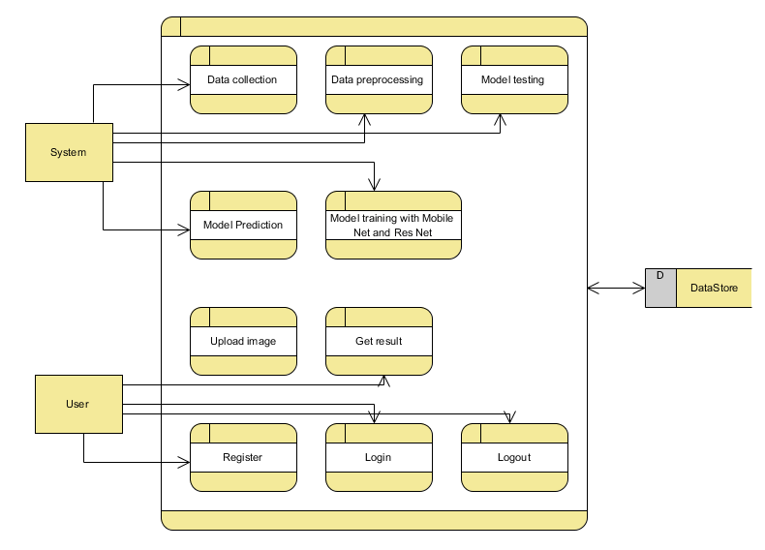
UML DIAGRAMS
Figure:Level-2 diagram

Slide 40
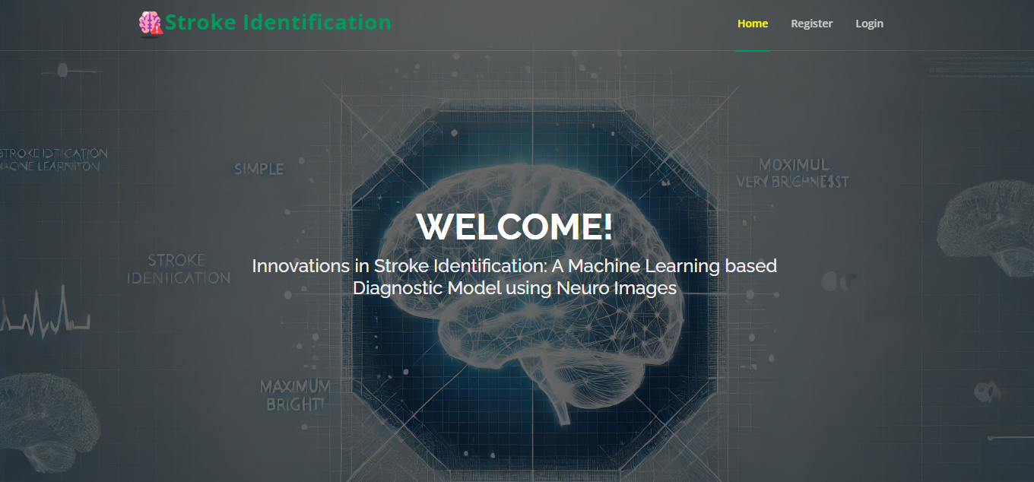
RESULTS AND SCREENSHOTS
HOME PAGE: This is the index Page of our website.

Slide 41
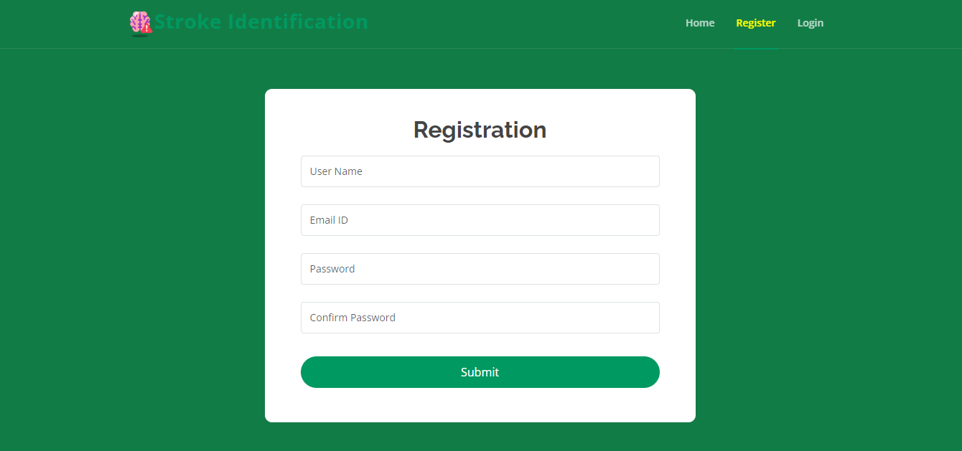
RESULTS AND SCREENSHOTS
REGISTRATION PAGE: User can register with their credentials.

Slide 42
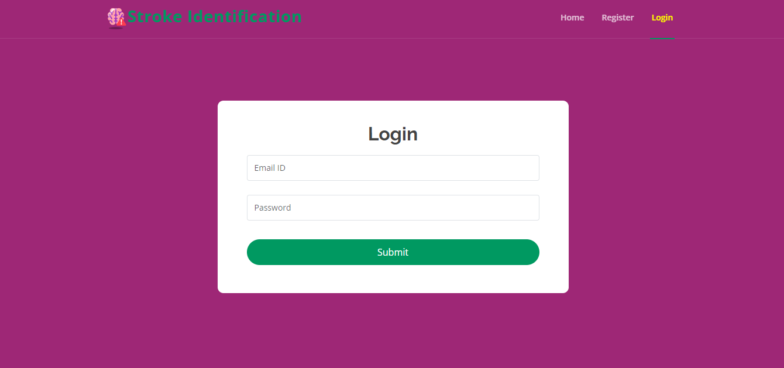
RESULTS AND SCREENSHOTS
LOGIN PAGE: User can login with their registered credentials.

Slide 43

RESULTS AND SCREENSHOTS
HOME PAGE: After user login this page will be come.

Slide 44
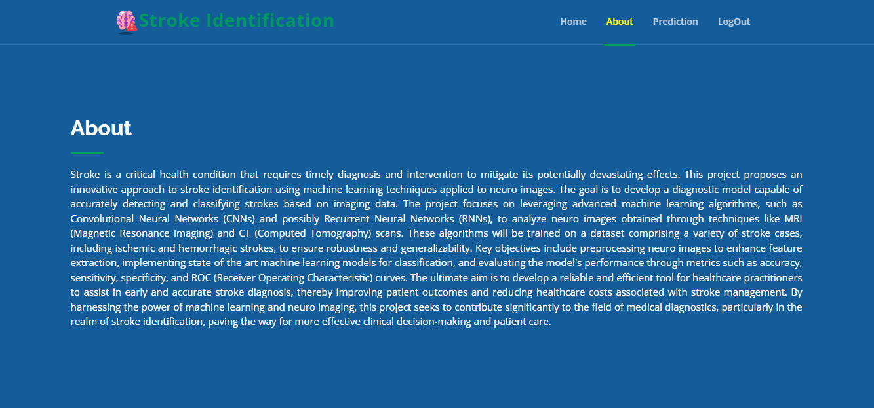
RESULTS AND SCREENSHOTS
ABOUT PAGE: This page contains about our website.

Slide 45
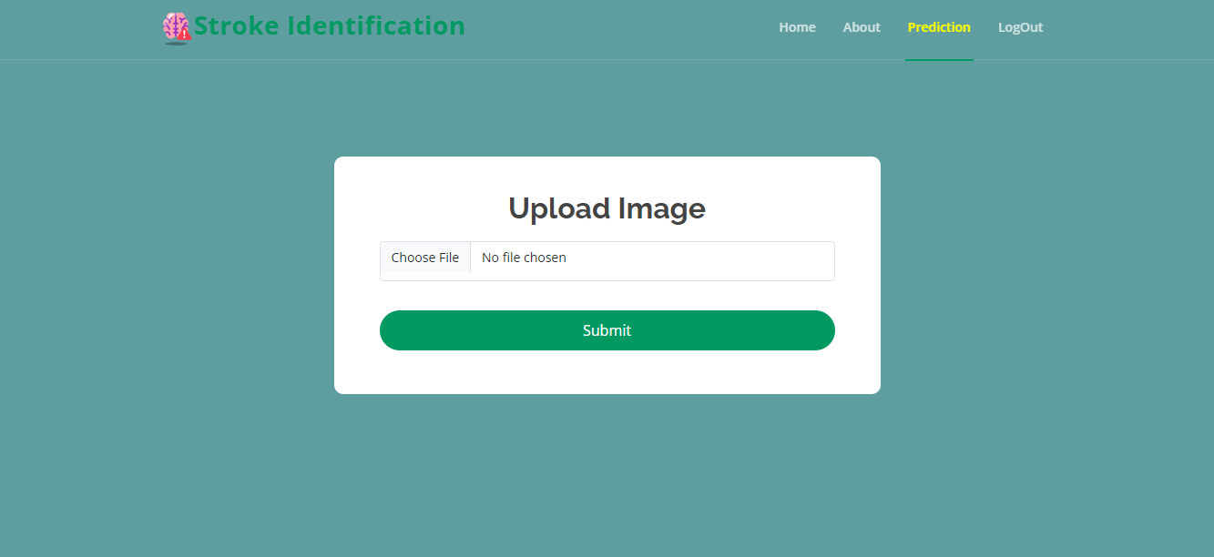
RESULTS AND SCREENSHOTS
PREDICTION PAGE: In here user can upload image and get prediction.

Slide 46
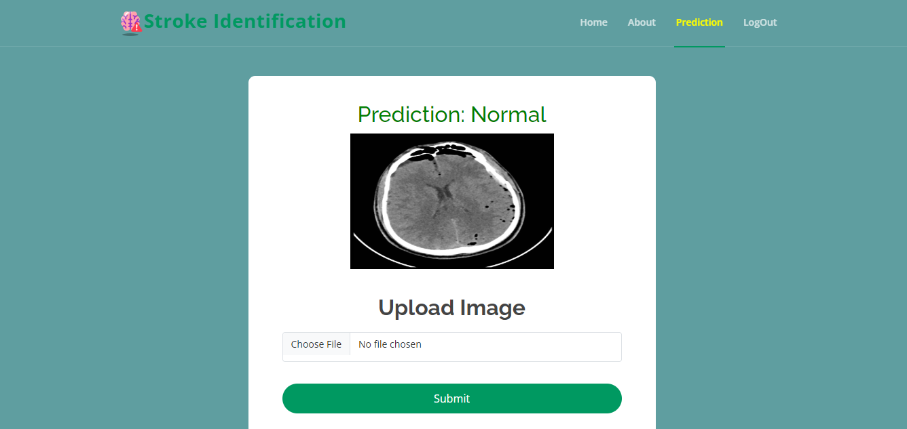
RESULTS AND SCREENSHOTS
RESULT PAGE: In here, user result will be display.
Prediction - Normal

Slide 47
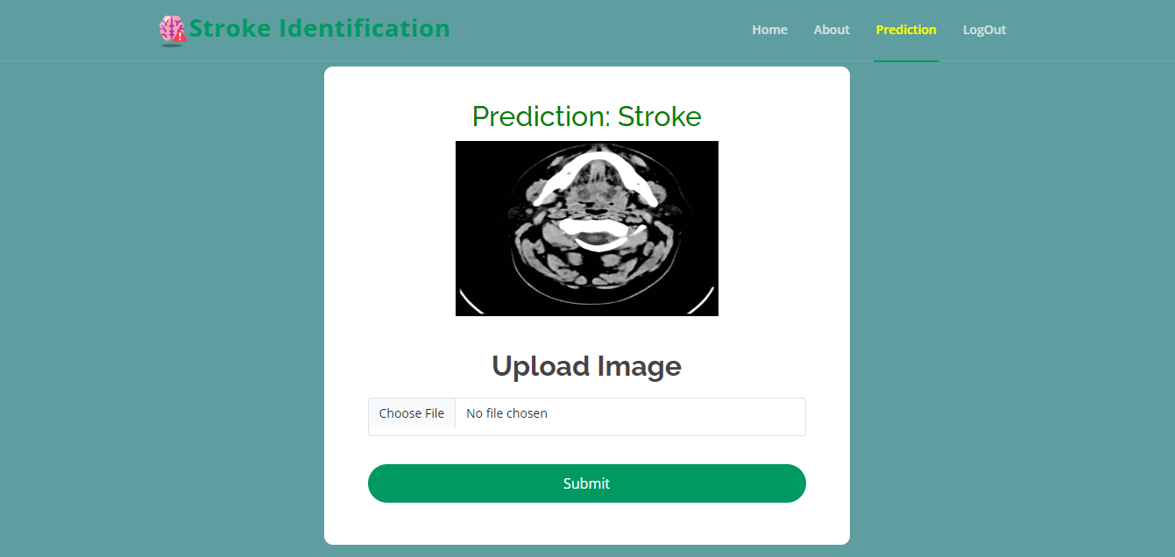
RESULTS AND SCREENSHOTS
RESULT PAGE: In here, user result will be display.
Prediction - Stroke

Slide 48
CONCLUSION
This study developed an innovative machine learning-based diagnostic model for stroke identification using ResNet and MobileNet architectures. By automating the classification of neuroimages into normal and stroke categories, the model addresses key limitations of traditional diagnostic methods, such as human error, variability, and time-consuming processes. The integration of this model into clinical workflows can significantly enhance diagnostic speed and consistency, facilitating timely interventions and ultimately improving patient outcomes. Our approach demonstrates the feasibility and potential of leveraging advanced deep learning architectures to enhance the accuracy and efficiency of medical diagnostics. The model's ability to handle large volumes of data efficiently makes it suitable for widespread clinical use. Future work will focus on further validation with larger datasets and real-world clinical trials to establish its efficacy and reliability in clinical settings. In conclusion, this research underscores the transformative potential of AI-driven solutions in healthcare. By providing clinicians with powerful diagnostic tools, we can improve the accuracy and speed of stroke diagnosis, reduce morbidity, and enhance the quality of life for patients. This study sets a precedent for the broader application of deep learning models in medical diagnostics, paving the way for more intelligent and efficient healthcare systems.

Slide 49
FUTURE WORK
Future enhancements for this study will focus on several key areas to further improve the efficacy and reliability of the machine learning-based diagnostic model for stroke identification. Incorporating larger and more diverse datasets will help validate the model's performance and ensure its generalizability across different populations and imaging conditions. Conducting extensive real-world clinical trials will provide critical insights into the model's practical application, refining and optimizing its functionality in actual clinical settings. Integrating additional data modalities, such as patient demographics, medical history, and other imaging techniques (e.g., MRI, CT scans), can enhance the model's diagnostic accuracy and provide a more comprehensive assessment of stroke. Exploring advanced optimization techniques and fine-tuning hyperparameters can further improve the model's efficiency and performance, making it more robust for clinical use. Developing a user-friendly interface for clinicians will facilitate easy adoption and integration into existing healthcare systems, ensuring that the model is accessible and practical for daily use. Implementing mechanisms for continuous learning and updating the model with new data will help maintain its relevance and accuracy over time. Partnering with healthcare institutions to gather feedback and insights will drive iterative improvements and ensure that the model meets the needs of clinicians and patients effectively. By addressing these areas, the diagnostic model can become a vital tool in the early detection and treatment of stroke, ultimately contributing to improved patient outcomes and advancing the field of medical diagnostics.

Slide 50
REFERENCES
1. Joo, H. S., & Park, D. G. (2018). Automatic Detection and Classification of Stroke using Machine Learning. IEEE Transactions on Biomedical Engineering.
2. Kamnitsas, K., Ledig, C., Newcombe, V. F., Simpson, J. P., Kane, A. D., Menon, D. K., & Glocker, B. (2017). Efficient Multi-Scale 3D CNN with Fully Connected CRF for Accurate Brain Lesion Segmentation. Medical Image Analysis, 36, 61-78.
3. Liu, L., Wang, H., Tian, X., & Wang, L. (2019). Deep Learning in Medical Ultrasound Image Analysis: A Review. IEEE Transactions on Neural Networks and Learning Systems.
4. Li, Z., Wang, Y., Yang, S., & Zhang, J. (2018). Brain Stroke Lesion Segmentation Using Convolutional Neural Networks. IEEE Transactions on Medical Imaging.
5. Xu, Y., Lin, Y., Zhu, Z., & Li, X. (2020). Stroke Lesion Detection in MRI Images using Deep Convolutional Neural Networks. Journal of Biomedical and Health Informatics.

Slide 51
REFERENCES
6. Litjens, G., Kooi, T., Bejnordi, B. E., Setio, A. A. A., Ciompi, F., Ghafoorian, M., ... & van Ginneken, B. (2017). A survey on deep learning in medical image analysis. Medical Image Analysis, 42, 60-88.
7. Shen, D., Wu, G., & Suk, H. I. (2017). Deep learning in medical image analysis. Annual Review of Biomedical Engineering, 19, 221-248.
8. He, K., Zhang, X., Ren, S., & Sun, J. (2016). Deep residual learning for image recognition. In Proceedings of the IEEE conference on computer vision and pattern recognition (pp. 770-778).
9. Howard, A. G., Zhu, M., Chen, B., Kalenichenko, D., Wang, W., Weyand, T., ... & Adam, H. (2017). MobileNets: Efficient convolutional neural networks for mobile vision applications. arXiv preprint arXiv:1704.04861.
10. Miotto, R., Wang, F., Wang, S., Jiang, X., & Dudley, J. T. (2018). Deep learning for healthcare: review, opportunities and challenges. Briefings in Bioinformatics, 19(6), 1236-1246.

